Slide 1
All the dSoftArk Tools
Getting started!

Slide 2
Tools
dSoftArk is a semi-realistic, agile, development project
  Industrial strength software (programming, TDD, testing, ant, external libraries)
  Many configurations (patterns, frameworks)
  Team effort (subversion)
Henrik Bærbak Christensen

Slide 3
Get started!
Get started right away!!!
Starting the day before delivery
... will make you fail!
Read link ’tool’ carefully from the web page...
Henrik Bærbak Christensen

Slide 4
Different paths...
”I want to work on my Windows 7 box”
  Path 1: install the complete tool suite
    All the hazzles
  Path 2: run a pre-installed VM
    Fewer hazzles but now you run Ubuntu instead
”I will use CS machines”
  All tools are installed
Henrik Bærbak Christensen

Slide 5
BlueJ
I really do not think it is a good idea
BlueJ’s focus is on novices...
  And it is good at it...
dSoftArk’s focus is on becoming experts...
  Understand what is under the hood...
Henrik Bærbak Christensen

Slide 6
Installing yourself
You have to (see hints on the tool page!)
  Get Java
  Get Ant
  Get SubVersion (commandline or explorer integrated)
  Get editor or IDE
    My preferences: Emacs and Eclipse
  Get mandatory project starting code
  UML drawings
    Visio (free) + Hruby’s stencils
    (see ”tool page” for alternatives)
Henrik Bærbak Christensen

Slide 7
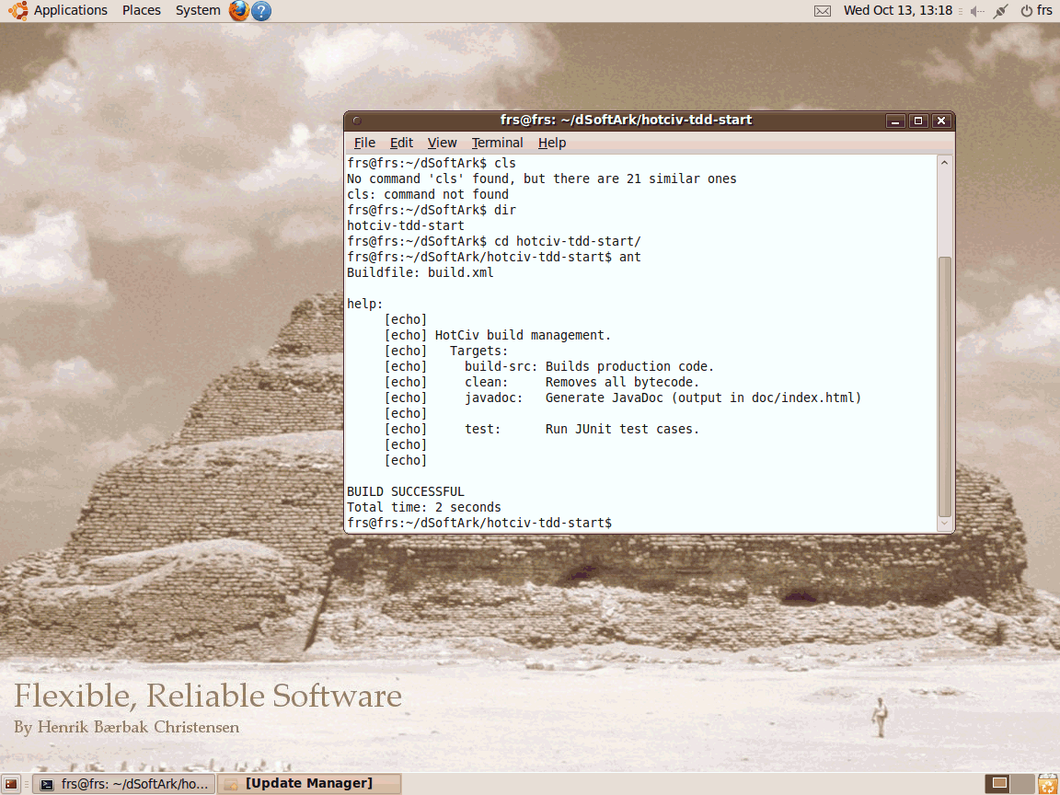
Pre-installed
Install a VMWare player (free)
Unzip ’ubuntu-for-dsoftark.zip’
Execute the VM
  Has eclipse
  Has FRS source
  Has mandatory proj.
Or – use a CS machine
  Install hot civ start
  yourself
Henrik Bærbak Christensen

Slide 8
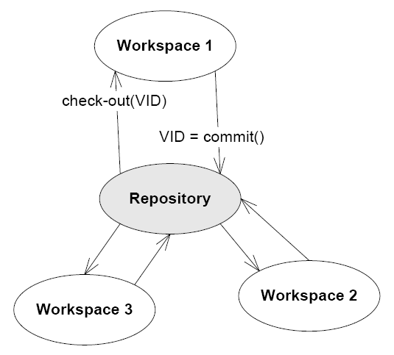
SubVersion
Subversion is a software configuration management tool.
  Single database contains all versions of your code
  Each developer works in his/her workspace
Henrik Bærbak Christensen

Slide 9
SubVersion
Setup!
  Staff will assign HTTP based repositories
    One per team, not one per person! TA’s will collect info
  Import hotciv project into the repository
Daily work
  Svn update (get latest changes into my workspace)
  Work (TDD)
  Svn commit (copy back your changes to database)
Read guides and/or watch (amateur) videos on tools page!
Henrik Bærbak Christensen

Slide 10
Build Management
... is an important topic in the book...
Build management = Automate house holding
  Smart recompilations of complete source trees
  Handles dependencies
    Test requires recompilation requires output folder create...
  Nice to have thingies
    JavaDoc for instance
Henrik Bærbak Christensen

Slide 11
Build Management
In dSoftArk it is a postulate – just use it!
  To recompile and run your JUnit test suite just
    ”ant test”
The Ant build file needs no modification for the first week
  Following weeks you need to add ’targets’ but it is more or less a matter of copy and paste...
Henrik Bærbak Christensen

Slide 12
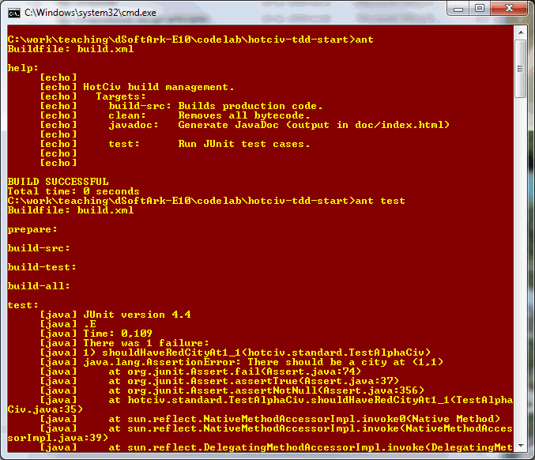
Demo
Henrik Bærbak Christensen

Slide 13
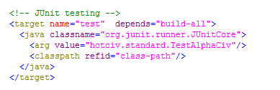
Interior of build.xml
The ’target’ to execute the test suite
Henrik Bærbak Christensen

Slide 14
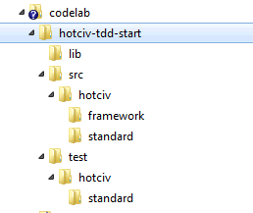
The folder / package structure
Package:
  hotciv.framework
  hotciv.standard
But two source trees
  src (production code)
  test (test code)
Read FRS 6.3.8
Henrik Bærbak Christensen

Slide 15
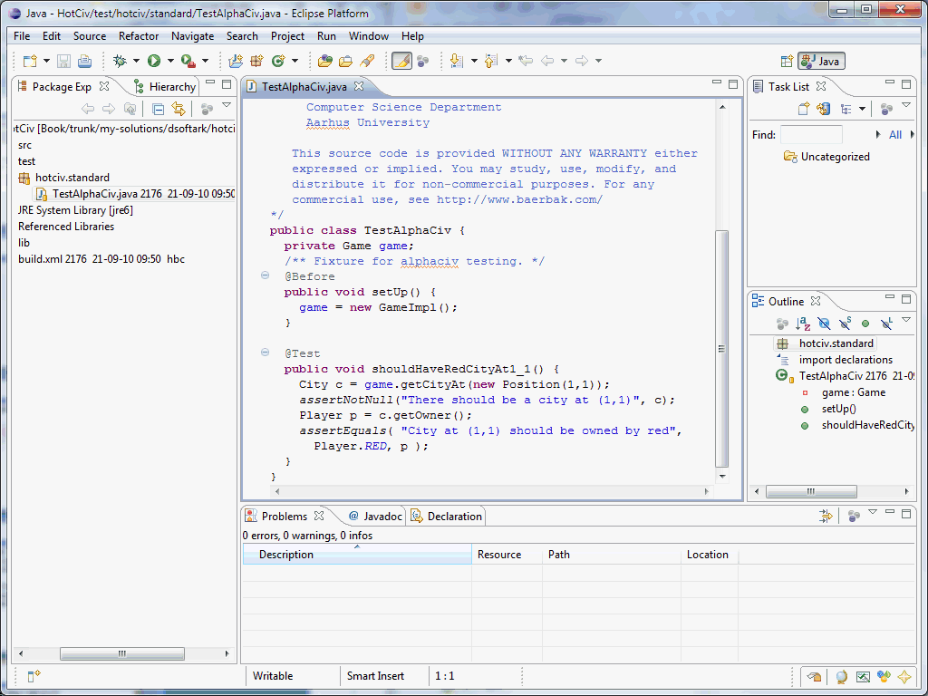
Alternative: Eclipse
Really efficient ☺
Once you master it ☹
  you can upgrade
  to eclipse later
  in the project!
You have to set
the Build path
  To include ‘test’
  To include JUnit
Henrik Bærbak Christensen

